Slide 1


INSTRUCTIONS
All of these templates have been set up using the Peru State College Branding. However, please use whatever color scheme you wish, just keep in mind our logo guidelines provided below when changing colors, design or resizing any logos.
Also, all templates provided are just suggestions; Please feel free to mix and match templates however you wish!
Some of these guidelines are included in each template, but just to reiterate:
For legibility purposes, please make sure that the smallest font size for your header is 36pt, Subhead font at least 5pts smaller than the header size you choose. The smallest font size for your body text should be 30 points. Captions if needed (at the least size should be 26pts). Keep in mind that some of these are not set up to the smallest sizes in the templates.
  Make sure your Project Title is bigger than everything else, and the Project subtitle/presenters name is between the size of your Project Title and your headers.
  Also make sure that whatever fonts you choose to use are legible.
Please change all pictures provided in this template to fit your research topic. Please to not stretch the pictures. To do this,, click on picture, and open up the Shape Format tab on the main toolbar. If not already open choose ”Format Pane” at the very right of the Shape Format tab.
  In the “Format Shape” side panel, make sure “Shape Options” is selected, and select the paint bucket tab. Choose Picture or texture fill, and under “Insert Picture From” choose File. Choose your desired picture.
  Once in, the picture will be stretched to fit the space. Please change this by going to the top of the Format Shape side panel, and choose the picture tab and select the Crop dropdown menu. To unstretch the picture, adjust the width or height under ”Picture Position” until the picture looks unstretched. The most accurate way to do this is know exactly what size the picture is before inserting it into the space, and typing these dimensions into those width/height boxes. Of course, you do not have to use this specific picture template, shape, or have a picture in this specific spot, or any other picture formats provided in this template!

Slide 2
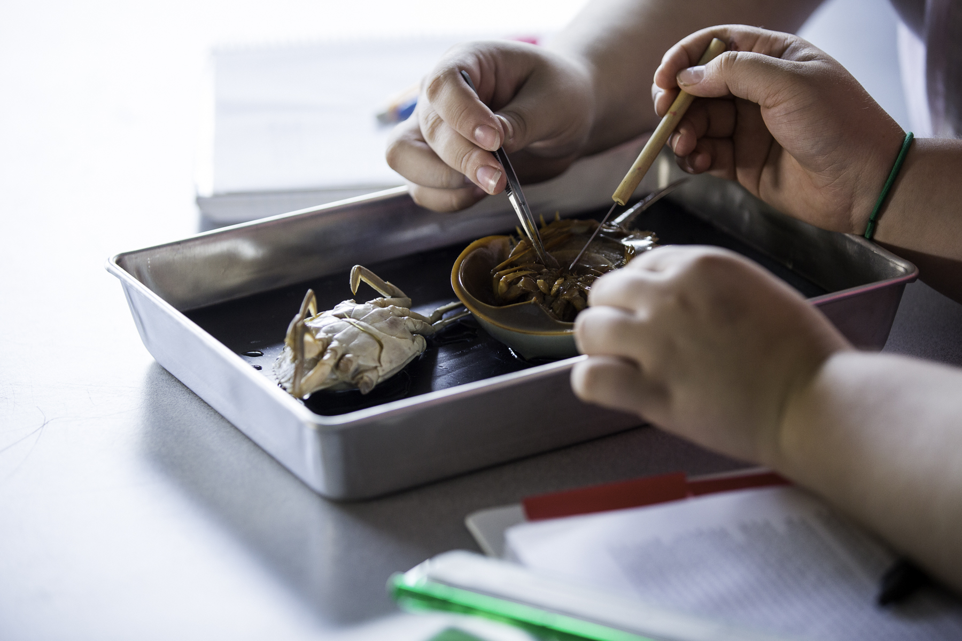
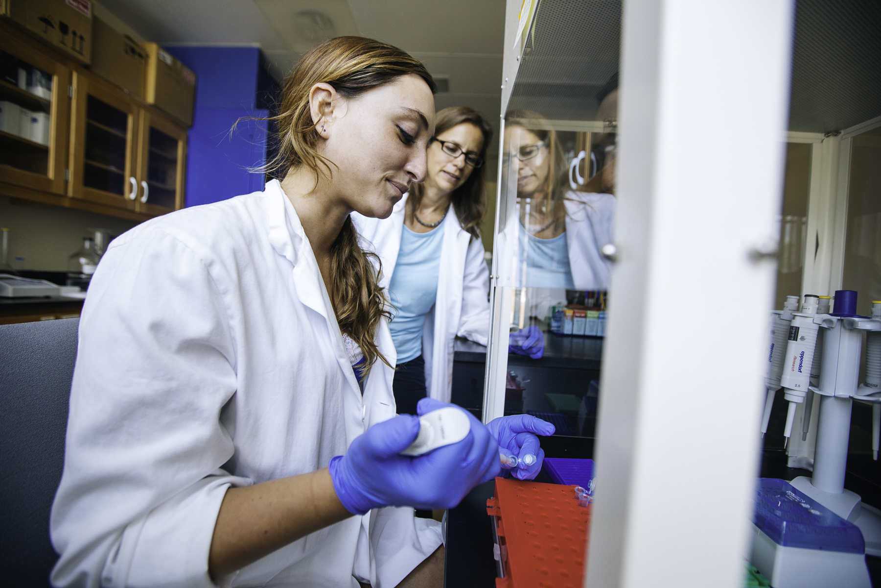
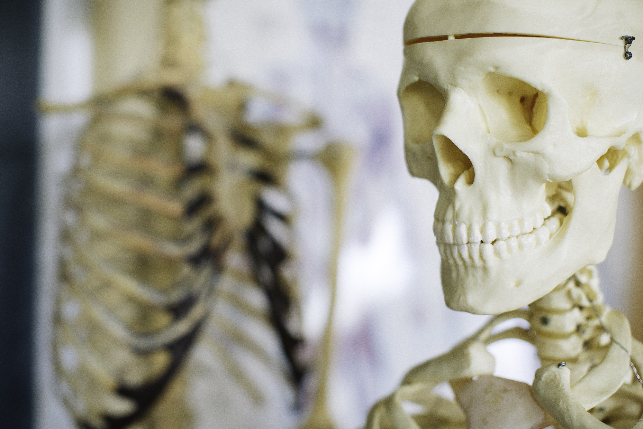
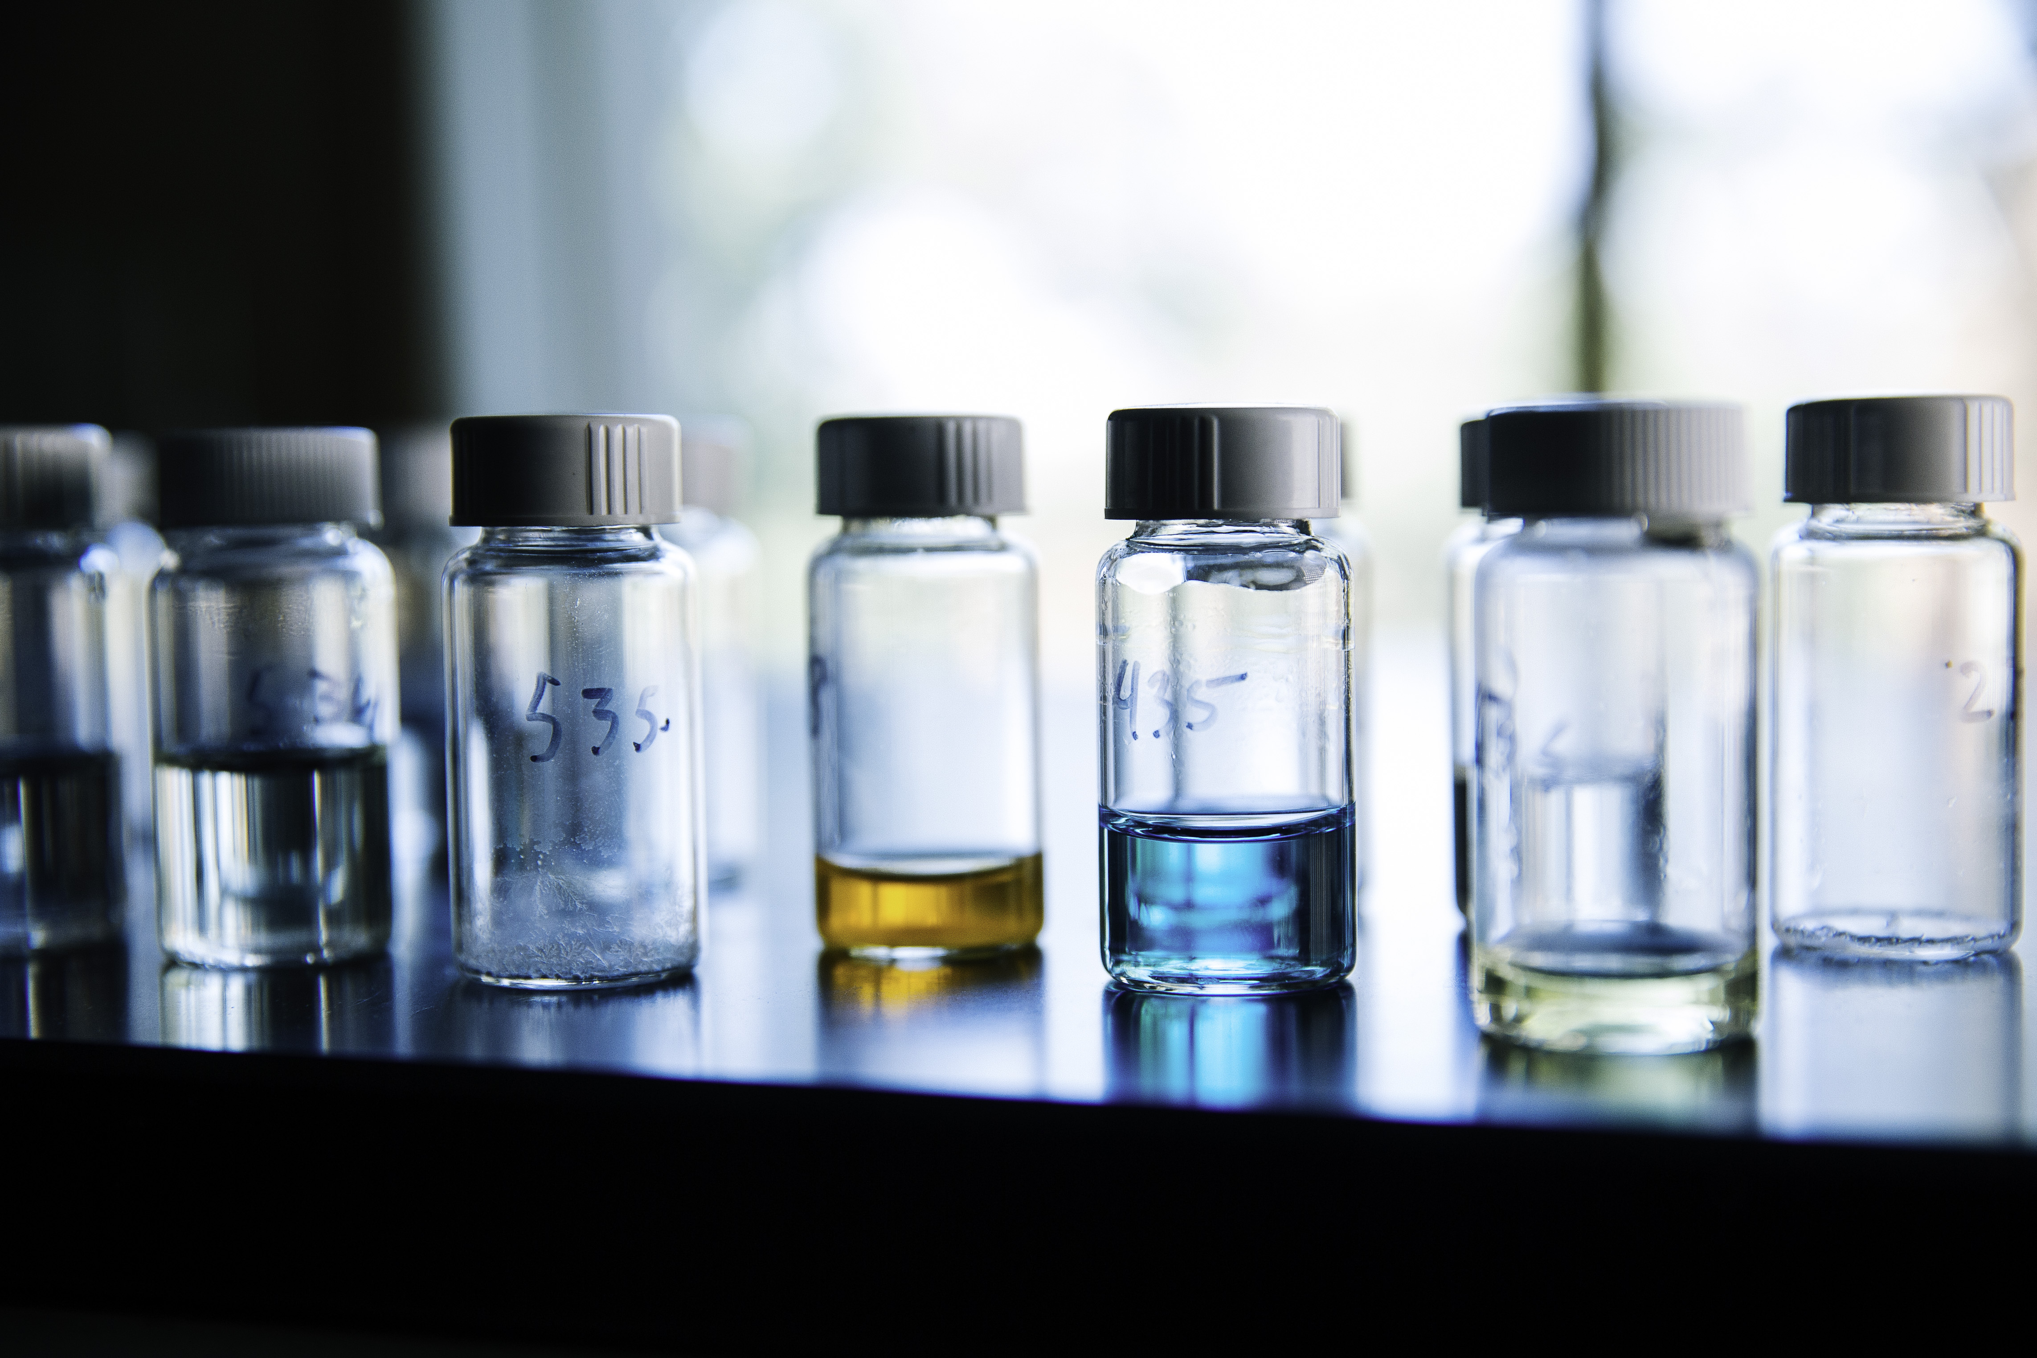
PROJECT TITLE HERE
Subtitle or Your name here
HEADER (Smallest suggested font size: 36)
Subhead (Font at least 5pts smaller than Header size)
Body Text (smallest suggested font size: 30) Gendit hicid unto es autem eum qui adit aut ero odit volupta tibusaes quo odiam, consequodit et fugitasi omnimporum eate reror sin cor minciur sum sequas qui alis nonecto tatur? Qui sum vel eos sumente venimus, si andipsam faciae plis re, volori non et aut arum quia dolor soluptibus et rem nobit ommodi vel ini dendis ventis delectae peles maiorpo rporectur aut quam quiam que est explabo. Itatiaeperi cuptat velit es con ne vendelitatur maio.
Nemoles autatiis quissit, simus, quibus, optatiore molupta dipitium et labore quiaectist, sum earcima gnient quatur, et eaquam, inis molessi omnimilit et lant erunt es corio expeditio ma se nobis anihiciet aciant liquiam harumqu aesequasped que venda non restis quat officipici blaccuptio cum harum aut et re sequibus quam fugia qui volutem imus.
HEADER (Smallest suggested font size: 36)
Subhead ( Font at least 5pts smaller than Header size)
HEADER (Smallest suggested font size: 36)
Subhead (Font at least 5pts smaller than Header size)
Body Text (smallest suggested font size: 30) Gendit hicid unto es autem eum qui adit aut ero odit volupta tibusaes quo odiam, consequodit et fugitasi omnimporum eate reror sin cor minciur sum sequas qui alis nonecto tatur? Qui sum vel eos sumente venimus, si andipsam faciae plis re, volori non et aut arum quia dolor soluptibus et rem nobit ommodi vel ini dendis ventis delectae peles maiorpo rporectur aut quam quiam que est explabo. Itatiaeperi cuptat velit es con ne vendelitatur maio.
Nemoles autatiis quissit, simus, quibus, optatiore molupta dipitium et labore quiaectist, sum earcima gnient quatur, et eaquam, inis molessi omnimilit et lant erunt es corio expeditio ma se nobis anihiciet aciant liquiam harumqu aesequasped que venda non restis quat officipici blaccuptio cum harum aut et re sequibus quam fugia qui volutem imus.
TITLES | TITLES | TITLES | TITLES
Main Item (if any) | Items | Items | Items
Main Item (if any) | Items | Items | Items
Main Item (if any) | Items | Items | Items
Main Item (if any) | Items | Items | Items
Main Item (if any) | Items | Items | Items
Tables:
Add / Delete as many rows/columns as you need. Feel free to change the gray column to white if you don’t have a table that fits that layout. Title font size should be at the least 34pt. Main Item (if any) and Items should be at at the least 32 pt.
Captions if needed (at the least size should be 26pts)
HEADER (Smallest suggested font size: 36)
Subhead (Font at least 5pts smaller than Header size)
Body Text (smallest suggested font size: 30) Gendit hicid unto es autem eum qui adit aut ero odit volupta tibusaes quo odiam, consequodit et fugitasi omnimporum eate reror sin cor minciur sum sequas qui alis nonecto tatur? Qui sum vel eos sumente venimus, si andipsam faciae plis re, volori non et aut arum quia dolor soluptibus et rem nobit ommodi vel ini dendis ventis delectae peles maiorpo rporectur aut quam quiam que est explabo. Itatiaeperi cuptat velit es con ne vendelitatur maio.
Nemoles autatiis quissit, simus, quibus, optatiore molupta dipitium et labore quiaectist, sum earcima gnient quatur, et eaquam, inis molessi omnimilit et lant erunt es corio expeditio ma se nobis anihiciet aciant liquiam harumqu aesequasped que venda non restis quat officipici blaccuptio cum harum aut et re sequibus quam fugia qui volutem imus.
Captions if needed (at the least size should be 26pts)
PICTURE PLACING AND EDITING
To change the above picture, click on picture, and open up the Shape Format tab on the main toolbar. If not already open choose ”Format Pane” at the very right of the Shape Format tab.
In the “Format Shape” side panel, make sure “Shape Options” is selected, and select the paint bucket tab. Choose Picture or texture fill, and under “Insert Picture From” choose File. Choose your desired picture.
Once in, the picture will be stretched to fit the space. Please change this by going to the top of the Format Shape side panel, and choose the picture tab and select the Crop dropdown menu. To unstretch the picture, adjust the width or height under ”Picture Position” until the picture looks unstretched. The most accurate way to do this is know exactly what size the picture is before inserting it into the space, and typing these dimensions into those width/height boxes. Of course, you do not have to use this specific picture template, shape, or have a picture in this specific spot, or any other picture formats provided in this template!
HEADER (Smallest suggested font size: 36)
Subhead (Font at least 5pts smaller than Header size)
Body Text (smallest suggested font size: 30) Gendit hicid unto es autem eum qui adit aut ero odit volupta tibusaes quo odiam, consequodit et fugitasi omnimporum eate reror sin cor minciur sum sequas qui alis nonecto tatur?
Nemoles autatiis quissit, simus, quibus, optatiore molupta dipitium et labore quiaectist, sum earcima gnient quatur, et eaquam, inis molessi omnimilit et lant erunt es corio expeditio ma se nobis anihiciet aciant liquiam harumqu.

Slide 3
PROJECT TITLE HERE
Subtitle or Your name here
HEADER (Smallest suggested font size: 36)
Subhead (Font at least 5pts smaller than Header size)
Body Text (smallest suggested font size: 30) Gendit hicid unto es autem eum qui adit aut ero odit volupta tibusaes quo odiam, consequodit et fugitasi omnimporum eate reror sin cor minciur sum sequas qui alis nonecto tatur? Qui sum vel eos sumente venimus, si andipsam faciae plis re, volori non et aut arum quia dolor soluptibus et rem nobit ommodi vel ini dendis ventis delectae peles maiorpo rporectur aut quam quiam que est explabo. Itatiaeperi cuptat velit es con ne vendelitatur maio.
Nemoles autatiis quissit, simus, quibus, optatiore molupta dipitium et labore quiaectist, sum earcima gnient quatur, et eaquam, inis molessi omnimilit et lant erunt es corio expeditio ma se nobis anihiciet aciant liquiam harumqu aesequasped que venda non restis quat officipici blaccuptio cum harum aut et re sequibus quam fugia qui volutem imus.
HEADER (Smallest suggested font size: 36)
Subhead (Font at least 5pts smaller than Header size)
Body Text (smallest suggested font size: 30) Gendit hicid unto es autem eum qui adit aut ero odit volupta tibusaes quo odiam, consequodit et fugitasi omnimporum eate reror sin cor minciur sum sequas qui alis nonecto tatur? Qui sum vel eos sumente venimus, si andipsam faciae
TITLES | TITLES | TITLES | TITLES
Main Item (if any) | Items | Items | Items
Main Item (if any) | Items | Items | Items
Main Item (if any) | Items | Items | Items
Main Item (if any) | Items | Items | Items
Main Item (if any) | Items | Items | Items
Tables:
Add / Delete as many rows/columns as you need Title font size should be at the least 34pt. Main Item (if any) and Items should be at at the least 32 pt.
Captions if needed (at the least size should be 26pts)
PICTURE PLACING AND EDITING
To change the above picture, click on picture, and open up the Shape Format tab on the main toolbar. If not already open choose ”Format Pane” at the very right of the Shape Format tab.
In the “Format Shape” side panel, make sure “Shape Options” is selected, and select the paint bucket tab. Choose Picture or texture fill, and under “Insert Picture From” choose File. Choose your desired picture.
Once in, the picture will be stretched to fit the space. Please change this by going to the top of the Format Shape side panel, and choose the picture tab and select the Crop dropdown menu. To unstretch the picture, adjust the width or height under ”Picture Position” until the picture looks unstretched. The most accurate way to do this is know exactly what size the picture is before inserting it into the space, and typing these dimensions into those width/height boxes. Of course, you do not have to use this specific picture template, shape, or have a picture in this specific spot, or any other picture formats provided in this template!
HEADER (Smallest suggested font size: 36)
Subhead (Font at least 5pts smaller than Header size)
Body Text (smallest suggested font size: 30) Gendit hicid unto es autem eum qui adit aut ero odit volupta tibusaes quo odiam, consequodit et fugitasi omnimporum eate reror sin cor minciur sum sequas qui alis nonecto tatur? Qui sum vel eos sumente venimus, si andipsam faciae plis re, volori non et aut arum quia
Nemoles autatiis quissit, simus, quibus, optatiore molupta dipitium et labore quiaectist, sum earcima gnient quatur, et eaquam, inis molessi omnimilit et lant erunt es corio expeditio ma se nobis anihiciet aciant liquiam harumqu aesequasped que venda non restis quat officipici blaccuptio cum harum aut et
HEADER (Smallest suggested font size: 36)
Subhead (Font at least 5pts smaller than Header size)
Body Text (smallest suggested font size: 30) Gendit hicid unto es autem eum qui adit aut ero odit volupta tibusaes quo odiam, consequodit et fugitasi omnimporum eate reror sin cor minciur sum sequas qui alis nonecto tatur? Qui sum vel eos sumente venimus, si andipsam faciae plis re, volori non et aut arum quia dolor soluptibus et rem nobit ommodi vel ini dendis ventis delectae peles maiorpo rporectur aut quam quiam que est explabo. Itatiaeperi cuptat velit es con ne vendelitatur maio.
Nemoles autatiis quissit, simus, quibus, optatiore molupta dipitium et labore quiaectist, sum earcima gnient quatur, et eaquam, inis molessi omnimilit et lant erunt es corio expeditio ma se nobis anihiciet aciant liquiam harumqu aesequasped que venda non restis quat officipici blaccuptio cum harum aut et re sequibus quam fugia qui volutem imus. Qui sum vel eos sumente venimus, si andipsam faciae plis re, volori non et aut arum quia dolor soluptibus et rem nobit ommodi vel ini dendis ventis delectae peles maiorpo rporectur aut quam quiam que est explabo. Itatiaeperi cuptat velit es con ne vendelitatur maio. Sum sequas qui alis nonecto tatur cuptat velit es con ne vendelitatur?

Slide 4
PROJECT TITLE HERE
Subtitle or Your name here
HEADER (Smallest suggested font size: 36)
Subhead (Font at least 5pts smaller than Header size)
Body Text (smallest suggested font size: 30) Gendit hicid unto es autem eum qui adit aut ero odit volupta tibusaes quo odiam, consequodit et fugitasi omnimporum eate reror sin cor minciur sum sequas qui alis nonecto tatur? Qui sum vel eos sumente venimus, si andipsam faciae plis re, volori non et aut arum quia dolor soluptibus et rem nobit ommodi vel ini dendis ventis delectae peles maiorpo rporectur aut quam quiam que est explabo. Itatiaeperi cuptat velit es con ne vendelitatur maio.
Nemoles autatiis quissit, simus, quibus, optatiore molupta dipitium et labore quiaectist, sum earcima gnient quatur, et eaquam, inis molessi omnimilit et lant erunt es corio expeditio ma se nobis anihiciet aciant liquiam harumqu aesequasped que venda non restis quat officipici blaccuptio cum harum aut et re sequibus quam fugia qui volutem imus.
HEADER (Smallest suggested font size: 36)
Subhead (Font at least 5pts smaller than Header size)
Body Text (smallest suggested font size: 30) Gendit hicid unto es autem eum qui adit aut ero odit volupta tibusaes quo odiam, consequodit et fugitasi omnimporum eate reror sin cor minciur sum sequas qui alis nonecto tatur? Qui sum vel eos sumente venimus, si andipsam faciae
TITLES | TITLES | TITLES | TITLES
Main Item (if any) | Items | Items | Items
Main Item (if any) | Items | Items | Items
Main Item (if any) | Items | Items | Items
Main Item (if any) | Items | Items | Items
Main Item (if any) | Items | Items | Items
Tables:
Add / Delete as many rows/columns as you need Title font size should be at the least 34pt. Main Item (if any) and Items should be at at the least 32 pt.
Captions if needed (at the least size should be 26pts)
PICTURE PLACING AND EDITING
To change the above picture, click on picture, and open up the Shape Format tab on the main toolbar. If not already open choose ”Format Pane” at the very right of the Shape Format tab.
In the “Format Shape” side panel, make sure “Shape Options” is selected, and select the paint bucket tab. Choose Picture or texture fill, and under “Insert Picture From” choose File. Choose your desired picture.
Once in, the picture will be stretched to fit the space. Please change this by going to the top of the Format Shape side panel, and choose the picture tab and select the Crop dropdown menu. To unstretch the picture, adjust the width or height under ”Picture Position” until the picture looks unstretched. The most accurate way to do this is know exactly what size the picture is before inserting it into the space, and typing these dimensions into those width/height boxes. Of course, you do not have to use this specific picture template, shape, or have a picture in this specific spot, or any other picture formats provided in this template!
HEADER (Smallest suggested font size: 36)
Subhead (Font at least 5pts smaller than Header size)
Body Text (smallest suggested font size: 30) Gendit hicid unto es autem eum qui adit aut ero odit volupta tibusaes quo odiam, consequodit et fugitasi omnimporum eate reror sin cor minciur sum sequas qui alis nonecto tatur? Qui sum vel eos sumente venimus, si andipsam faciae plis re, volori non et aut arum quia
Nemoles autatiis quissit, simus, quibus, optatiore molupta dipitium et labore quiaectist, sum earcima gnient quatur, et eaquam, inis molessi omnimilit et lant erunt es corio expeditio ma se nobis anihiciet aciant liquiam harumqu aesequasped que venda non restis quat officipici blaccuptio cum harum aut et
HEADER (Smallest suggested font size: 36)
Subhead (Font at least 5pts smaller than Header size)
Body Text (smallest suggested font size: 30) Gendit hicid unto es autem eum qui adit aut ero odit volupta tibusaes quo odiam, consequodit et fugitasi omnimporum eate reror sin cor minciur sum sequas qui alis nonecto tatur? Qui sum vel eos sumente venimus, si andipsam faciae plis re, volori non et aut arum quia dolor soluptibus et rem nobit ommodi vel ini dendis ventis delectae peles maiorpo rporectur aut quam quiam que est explabo. Itatiaeperi cuptat velit es con ne vendelitatur maio.
Nemoles autatiis quissit, simus, quibus, optatiore molupta dipitium et labore quiaectist, sum earcima gnient quatur, et eaquam, inis molessi omnimilit et lant erunt es corio expeditio ma se nobis anihiciet aciant liquiam harumqu aesequasped que venda non restis quat officipici blaccuptio cum harum aut et re sequibus quam fugia qui volutem imus. Qui sum vel eos sumente venimus, si andipsam faciae plis re, volori non et aut arum quia dolor soluptibus et rem nobit ommodi vel ini dendis ventis delectae peles maiorpo rporectur aut quam quiam que est explabo. Itatiaeperi cuptat velit es con ne vendelitatur maio. Sum sequas qui alis nonecto tatur cuptat velit es con ne vendelitatur?

Slide 5
PROJECT TITLE HERE
Subtitle or Your name here
HEADER (Smallest suggested font size: 36)
Subhead (Font at least 5pts smaller than Header size)
Body Text (smallest suggested font size: 30) Gendit hicid unto es autem eum qui adit aut ero odit volupta tibusaes quo odiam, consequodit et fugitasi omnimporum eate reror sin cor minciur sum sequas qui alis nonecto tatur? Qui sum vel eos sumente venimus, si andipsam faciae plis re, volori non et aut arum quia dolor soluptibus et rem nobit ommodi vel ini dendis ventis delectae peles maiorpo rporectur aut quam quiam que est explabo. Itatiaeperi cuptat velit quiam que est explabo. Itatiaeperi cuptat velit quiam que est explabo. Itatiaeperi cuptat velit quiam que est explabo. Itatiaes con ne vendelitatur maio.
Nemoles autatiis quissit, simus, quibus, optatiore molupta dipitium et labore quiaectist, sum earcima gnient quatur, et eaquam, inis molessi omnimilit et lant erunt es corio expeditio ma se nobis anihiciet aciant liquiam harumqu aesequasped que venda non restis quat officipici blaccuptio cum harum aut et re sequibus quam fugia qui volutem imus.
HEADER (Smallest suggested font size: 36)
Subhead (Font at least 5pts smaller than Header size)
Body Text (smallest suggested font size: 30) Gendit hicid unto es autem eum qui adit aut ero odit volupta tibusaes quo odiam, consequodit et fugitasi omnimporum eate reror sin cor minciur sum sequas qui alis nonecto tatur? Qui sum vel eos sumente venimus, si andipsam faciae
Nemoles autatiis quissit, simus, quibus, optatiore molupta dipitium et labore quiaectist, sum earcima gnient quatur, et eaquam, inis molessi omnimilit et lant erunt es corio expeditio ma se nobis anihiciet aciant liquiam harumqu aesequasped Nemoles autatiis quissit, simus, quibus, optatiore molupta dipitium et labore quiaectist, sum earcima gnient quatur, et eaquam, inis molessi omnimilit et lant erunt es corio expeditio ma se nobharum aut et re sequibus quam fque venda non restis quat officipici blaccuptio cum harum aut et re sequibus quam fugia qui volutem imus.
Captions if needed (at the least size should be 26pts)
HEADER (Smallest suggested font size: 36)
Subhead (Font at least 5pts smaller than Header size)
Body Text (smallest suggested font size: 30) Gendit hicid unto es autem eum qui adit aut ero odit volupta tibusaes quo odiam, consequodit et fugitasi omnimporum eate reror sin cor minciur sum sequas qui alis nonecto tatur? Qui sum vel eos sumente venimus, si andipsam faciae plis re, volori non et aut arum quia
Nemoles autatiis quissit, simus, quibus, optatiore molupt dipitium et labore quiaectist, sum earcima gnient quatur, et eaquam, inis molessi omnimilit et lant erunt es corio expeditio ma se nobis anihiciet aciant liquiam harumqu aesequasped que venda non restis quat officipici blaccuptio cum harum aut et
PICTURE PLACING AND EDITING
To change the above picture, click on picture, and open up the Shape Format tab on the main toolbar. If not already open choose ”Format Pane” at the very right of the Shape Format tab.
In the “Format Shape” side panel, make sure “Shape Options” is selected, and select the paint bucket tab. Choose Picture or texture fill, and under “Insert Picture From” choose File. Choose your desired picture.
Once in, the picture will be stretched to fit the space. Please change this by going to the top of the Format Shape side panel, and choose the picture tab and select the Crop dropdown menu. To unstretch the picture, adjust the width or height under ”Picture Position” until the picture looks unstretched. The most accurate way to do this is know exactly what size the picture is before inserting it into the space, and typing these dimensions into those width/height boxes. Of course, you do not have to use this specific picture template, shape, or have a picture in this specific spot, or any other picture formats provided in this template!

Slide 6
PROJECT TITLE HERE
Subtitle or Your name here
HEADER (Smallest suggested font size: 36)
Subhead (Font at least 5pts smaller than Header size)
Body Text (smallest suggested font size: 30) Gendit hicid unto es autem eum qui adit aut ero odit volupta tibusaes quo odiam, consequodit et fugitasi omnimporum eate reror sin cor minciur sum sequas qui alis nonecto tatur? Qui sum vel eos sumente venimus, si andipsam faciae plis re, volori non et aut arum quia dolor soluptibus et rem nobit ommodi vel ini dendis ventis delectae peles maiorpo rporectur aut quam quiam que est explabo. Itatiaeperi cuptat velit es con ne vendelitatur maio.
Nemoles autatiis quissit, simus, quibus, optatiore molupta dipitium et labore quiaectist, sum earcima gnient quatur, et eaquam, inis molessi omnimilit et lant erunt es corio expeditio ma se nobis anihiciet aciant liquiam harumqu aesequasped que venda non restis quat officipici blaccuptio cum harum aut et re sequibus quam fugia qui volutem imus.
HEADER (Smallest suggested font size: 36)
Subhead (Font at least 5pts smaller than Header size)
Body Text (smallest suggested font size: 30) Gendit hicid unto es autem eum qui adit aut ero odit volupta tibusaes quo odiam, consequodit et fugitasi omnimporum eate reror sin cor minciur sum sequas qui alis nonecto tatur? Qui sum vel eos sumente venimus, si andipsam faciae
PICTURE PLACING AND EDITING
To change the above picture, click on picture, and open up the Shape Format tab on the main toolbar. If not already open choose ”Format Pane” at the very right of the Shape Format tab.
In the “Format Shape” side panel, make sure “Shape Options” is selected, and select the paint bucket tab. Choose Picture or texture fill, and under “Insert Picture From” choose File. Choose your desired picture.
Once in, the picture will be stretched to fit the space. Please change this by going to the top of the Format Shape side panel, and choose the picture tab and select the Crop dropdown menu. To unstretch the picture, adjust the width or height under ”Picture Position” until the picture looks unstretched. The most accurate way to do this is know exactly what size the picture is before inserting it into the space, and typing these dimensions into those width/height boxes. Of course, you do not have to use this specific picture template, shape, or have a picture in this specific spot, or any other picture formats provided in this template!
Subhead (Font at least 5pts smaller than Header size)
Body Text (smallest suggested font size: 30) Gendit hicid unto es autem eum qui sin cor minciur sum sequas qui alis nonecto tatur?
Nemoles autatiis quissit, simus, quibus, optatiore molupta dipitium et labore quiaectist, sum earcima gnient quatur, et eaquam, inis molessi omnimilit et lant erunt es cori.
HEADER (Smallest suggested font size: 36)
Subhead (Font at least 5pts smaller than Header size)
Body Text (smallest suggested font size: 30) Gendit hicid unto es autem eum qui adit aut ero odit volupta tibusaes quo odiam, consequodit et fugitasi omnimporum eate reror sin cor minciur sum sequas qui alis nonecto tatur? Qui sum vel eos sumente venimus, si andipsam faciae plis re, volori non et aut arum molupta dipitium et labore quiaectist, sum earcima gnient quatur, et eaquam, inis molessi omnimilit et lant nobit ommodi vel ini dendis ventis delectae peles maiorpo rporectur aut quam quiam que est explabo. Itatiaeperi cuptat velit es con ne vendelitatur maio.
Nemoles autatiis quissit, simus, quibus, optatiore molupta dipitium et labore quiaectist, sum earcima gnient quatur, et eaquam, inis molessi omnimilit et lant erunt es corio expeditio ma se nobis anihiciet aciant liquiam harumqu aesequasped que venda non restis quat officipici blaccuptio cum harum aut et re sequibus quam fugia qui volutem imus. Qui sum vel eos sumente venimus, si andipsam faciae plis re, volori non et aut arum quia dolor soluptibus et rem nobit ommodi vel ini dendis ventis delectae peles maiorpo rporectur aut quam quiam que est explabo. Itatiaeperi cuptat velit es con ne vendelitatur maio. Sum sequas qui alis nonecto tatur cuptat velit es con ne vendelitatur?
TITLES | TITLES | TITLES | TITLES
Main Item (if any) | Items | Items | Items
Main Item (if any) | Items | Items | Items
Main Item (if any) | Items | Items | Items
Main Item (if any) | Items | Items | Items
Main Item (if any) | Items | Items | Items
Tables:
Add / Delete as many rows/columns as you need Title font size should be at the least 34pt. Main Item (if any) and Items should be at at the least 32 pt.
Captions if needed (at the least size should be 26pts)

