Slide 1


INSTRUCTIONS
All of these templates have been set up using the Peru State College Branding. However, please use whatever color scheme you wish, just keep in mind our logo guidelines provided on the right when changing colors, design or resizing any logos.
Also, all templates provided are just suggestions; Please feel free to mix and match templates however you wish!
Some of these guidelines are included in each template,
but just to reiterate:
For legibility purposes, please make sure that the smallest font size for your header is 36pt, Subhead font at least 5pts smaller than the header size you choose. The smallest font size for your body text should be 30 points. Captions if needed (at the least size should be 26pts). Keep in mind that some of these are not set up to the smallest sizes in the templates.
  Make sure your Project Title is bigger than everything else, and the Project subtitle/presenters name is between the size of your Project Title and your headers.
  Also make sure that whatever fonts you choose to use are legible.
Please change all pictures provided in this template to fit your research topic. Please do not stretch the pictures. Instead, click on picture, and open up the Shape Format tab on the main toolbar. If not already open choose ”Format Pane” at the very right of the Shape Format tab.
  In the “Format Shape” side panel, make sure “Shape Options” is selected, and select the paint bucket tab. Choose Picture or texture fill, and under “Insert Picture From” choose File. Choose your desired picture.
  Once in, the picture will be stretched to fit the space. Please change this by going to the top of the Format Shape side panel, and choose the picture tab and select the Crop dropdown menu. To unstretch the picture, adjust the width or height under ”Picture Position” until the picture looks unstretched. The most accurate way to do this is know exactly what size the picture is before inserting it into the space, and typing these dimensions into those width/height boxes. Of course, you do not have to use this specific picture template, shape, or have a picture in this specific spot, or any other picture formats provided in this template!

Slide 2
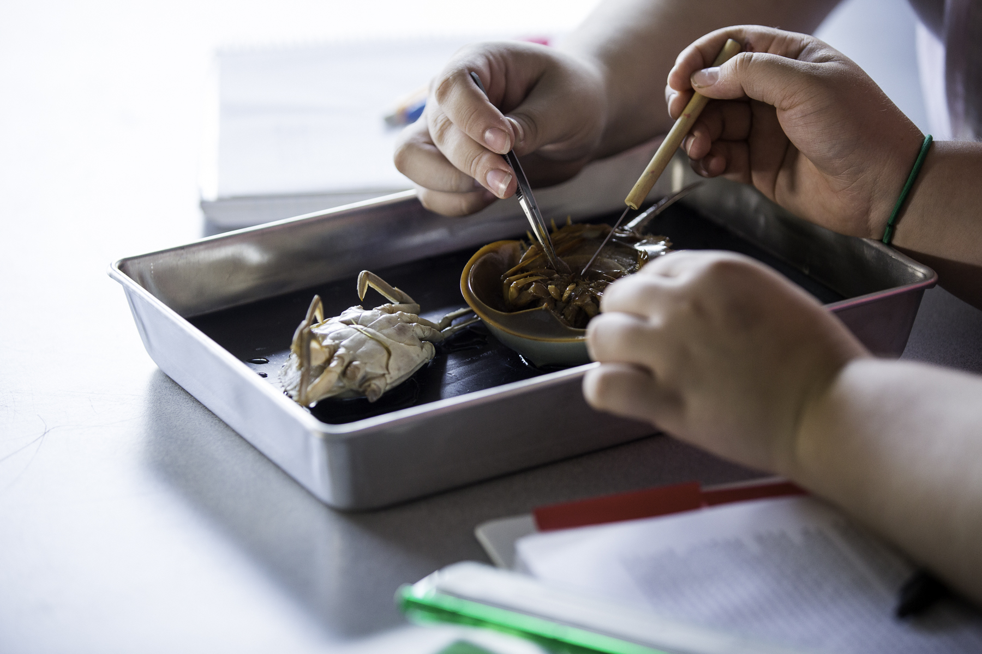
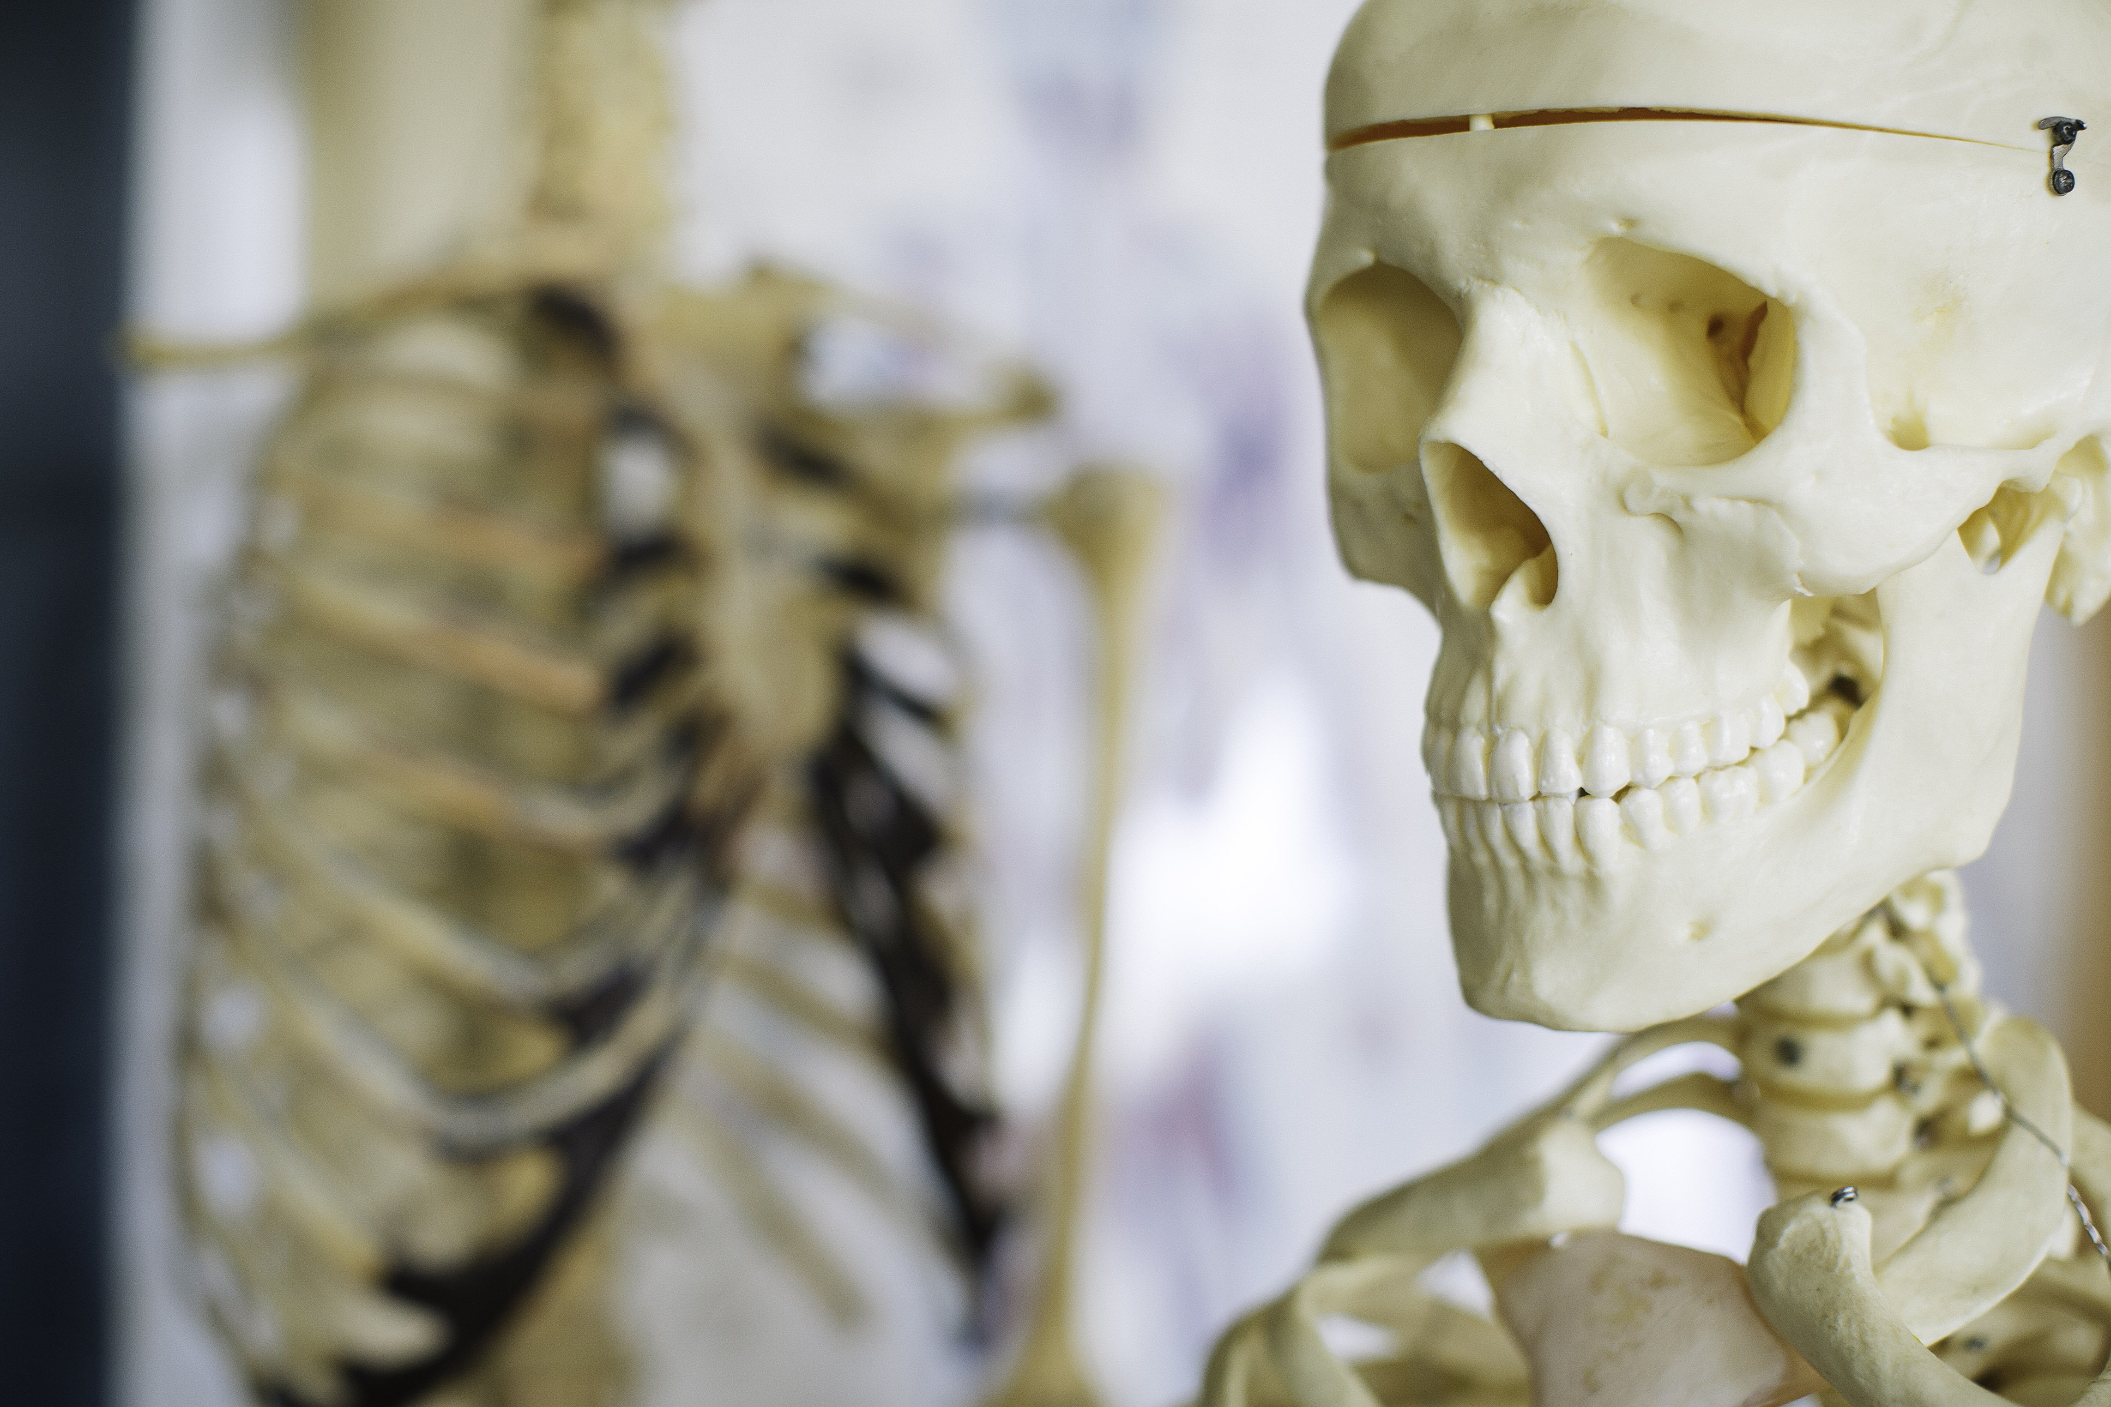
PROJECT TITLE HERE
Subtitle or Your name here
HEADER (Smallest suggested font size: 36)
Subhead (Font at least 5pts smaller than Header size)
Body Text (smallest suggested font size: 30) Gendit hicid unto es autem eum qui adit aut ero odit volupta tibusaes quo odiam, consequodit et fugitasi omnimporum eate reror sin cor minciur sum sequas qui alis nonecto tatur? Qui sum vel eos sumente venimus, si andipsam faciae plis re.
volori non et aut arum quia dolor soluptibus et rem nobit ommodi vel ini dendis ventis delectae peles maiorpo rporectur aut quam quiam que est explabo. Itatiaeperi cuptat velit es con ne vendelitatur maio.
HEADER (Smallest suggested font size : 36)
Subhead ( Font at least 5pts smaller than Header size)
HEADER (Smallest suggested font size: 36)
Subhead (Font at least 5pts smaller than Header size)
TITLES | TITLES | TITLES | TITLES
Main Item (if any) | Items | Items | Items
Main Item (if any) | Items | Items | Items
Main Item (if any) | Items | Items | Items
Main Item (if any) | Items | Items | Items
Main Item (if any) | Items | Items | Items
Tables:
Add / Delete as many rows/columns as you need. Feel free to change the gray column to white if you don’t have a table that fits that layout. Title font size should be at the least 34pt. Main Item (if any) and Items should be at at the least 32 pt.
Body Text (smallest suggested font size: 30) Gendit hicid unto es autem eum qui adit aut ero odit volupta tibusaes quo odiam, consequodit et fugitasi omnimporum eate reror sin cor minciur sum sequas qui alis nonecto tatur? Qui sum vel eos sumente venimus, si andipsam faciae plis re, volori non et aut arum quia dolor soluptibus et rem nobit ommodi vel ini dendis ventis delectae peles maiorpo rporectur aut quam quiam que est explabo. Itatiaeperi cuptat velit es con ne vendelitatur maio.
Nemoles autatiis quissit, simus, quibus, optatiore molupta dipitium et labore quiaectist, sum earcima gnient quatur, et eaquam, inis molessi omnimilit et lant erunt es corio expeditio ma se nobis anihiciet aciant liquiam harumqu aesequasped que venda non restis quat officipici blaccuptio cum harum aut et re sequibus quam fugia qui volutem imus.
Captions if needed (at the least size should be 26pts)
PICTURE PLACING AND EDITING
To change the above picture, click on picture, and open up the Shape Format tab on the main toolbar. If not already open choose ”Format Pane” at the very right of the Shape Format tab.
In the “Format Shape” side panel, make sure “Shape Options” is selected, and select the paint bucket tab. Choose Picture or texture fill, and under “Insert Picture From” choose File. Choose your desired picture.
Once in, the picture will be stretched to fit the space. Please change this by going to the top of the Format Shape side panel, and choose the picture tab and select the Crop dropdown menu. To unstretch the picture, adjust the width or height under ”Picture Position” until the picture looks unstretched. The most accurate way to do this is know exactly what size the picture is before inserting it into the space, and typing these dimensions into those width/height boxes. Of course, you do not have to use this specific picture template, shape, or have a picture in this specific spot, or any other picture formats provided in this template!
Subhead
Body Text: Nemoles autatiis quissit, simus, quibus, optatiore molupta dipitium et labore quiaectist, sum earcima gnient quatur, et eaquam, inis molessi omnimilit et lant erunt es corio expeditio ma se nobis. Earcima gnient quatur, et eaquam, inis molessi omnimilit et lant erunt es corio expeditio ma se nobis.
Nemoles autatiis quissit, simus, quibus, optatiore molupta dipitium et labore quiaectist, sum earcima gnient quatur, et eaquam, inis molessi omnimilit et lant erunt es corio expeditio ma se nobis. Earcima gnient quatur, et eaquam, inis molessi omnimilit et lant erunt es corio expeditio ma se nobis. Nemoles autatiis quissit, simus, quibus, optatiore molupta dipitium et labore quiaectist, sum earcima gnient quatur, et eaquam, inis molessi omnimilit et lant erunt es corio expeditio ma se nobis. Earcima gnient quatur.
Captions if needed (at the least size should be 26pts)

Slide 3
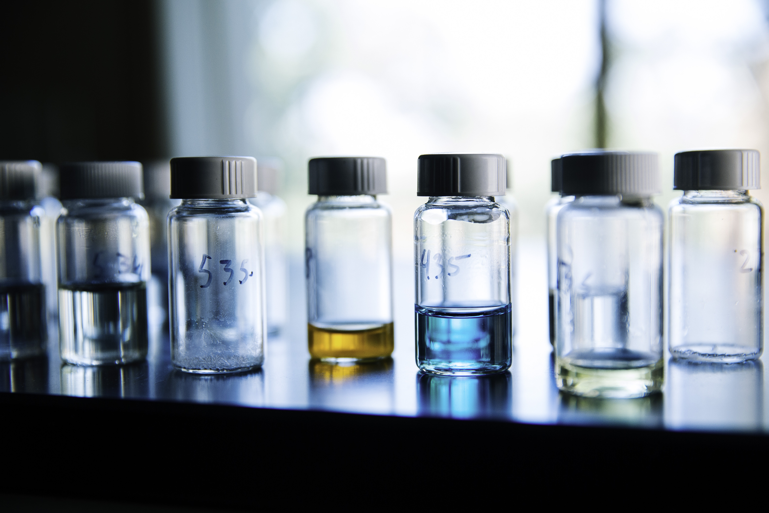
PROJECT TITLE HERE
Your name here
HEADER (Smallest suggested font size: 36)
Subhead (Font at least 5pts smaller than Header size)
Body Text (smallest suggested font size: 30) Gendit hicid unto es autem eum qui adit aut ero odit volupta tibusaes quo odiam, consequodit et fugitasi omnimporum eate reror sin cor minciur sum sequas qui alis nonecto tatur? Qui sum vel eos sumente venimus, si andipsam faciae plis re, volori non et aut arum quia dolor soluptibus et rem nobit ommodi vel ini dendis ventis delectae peles maiorpo rporectur aut quam quiam que est explabo. Itatiaeperi cuptat velit es con ne vendelitatur maio.
Nemoles autatiis quissit, simus, quibus, optatiore molupta dipitium et labore quiaectist, sum earcima gnient quatur, et eaquam, inis molessi omnimilit et lant erunt es corio expeditio ma se nobis anihiciet aciant liquiam harumqu aesequasped que venda non restis quat officipici blaccuptio cum harum aut et re sequibus quam fugia qui volutem imus.
HEADER (Smallest suggested font size: 36)
Subhead ( Font at least 5pts smaller than Header size)
Tables:
Add / Delete as many rows/columns as you need. Feel free to change the gray column to white if you don’t have a table that fits that layout. Title font size should be at the least 34pt. Main Item (if any) and Items should be at at the least 32 pt.
HEADER (Smallest suggested font size: 36)
Subhead (Font at least 5pts smaller than Header size)
TITLES | TITLES | TITLES | TITLES
Main Item (if any) | Items | Items | Items
Main Item (if any) | Items | Items | Items
Main Item (if any) | Items | Items | Items
Main Item (if any) | Items | Items | Items
Main Item (if any) | Items | Items | Items
Body Text (smallest suggested font size: 30) Gendit hicid unto es autem eum qui adit aut ero odit volupta tibusaes quo odiam, consequodit et fugitasi omnimporum eate reror sin cor minciur sum sequas qui alis nonecto tatur? Qui sum vel eos sumente venimus, si andipsam faciae plis re, volori non et aut arum quia dolor soluptibus et rem nobit ommodi vel ini dendis ventis delectae peles maiorpo rporectur aut quam quiam que est explabo. Itatiaeperi cuptat velit es con ne vendelitatur maio.
Nemoles autatiis quissit, simus, quibus, optatiore molupta dipitium et labore quiaectist, sum earcima gnient quatur, et eaquam, inis molessi omnimilit et lant erunt es corio expeditio ma se nobis anihiciet aciant liquiam harumqu aesequasped que venda non restis quat officipici blaccuptio cum harum aut et re sequibus quam fugia qui volutem imus.
Captions if needed (at the least size should be 26pts)
Captions if needed (at the least size should be 26pts)
Subhead
Body Text: Nemoles autatiis quissit, simus, quibus, optatiore molupta dipitium et labore quiaectist, sum earcima gnient quatur, et eaquam, inis molessi omnimilit et lant erunt es corio expeditio ma se nobis. Earcima gnient quatur, et eaquam, inis molessi omnimilit et lant erunt es corio expeditio ma se nobis.
PICTURE PLACING AND EDITING
To change the above picture, click on picture, and open up the Shape Format tab on the main toolbar. If not already open choose ”Format Pane” at the very right of the Shape Format tab.
In the “Format Shape” side panel, make sure “Shape Options” is selected, and select the paint bucket tab. Choose Picture or texture fill, and under “Insert Picture From” choose File. Choose your desired picture.
Once in, the picture will be stretched to fit the space. Please change this by going to the top of the Format Shape side panel, and choose the picture tab and select the Crop dropdown menu. To unstretch the picture, adjust the width or height under ”Picture Position” until the picture looks unstretched. The most accurate way to do this is know exactly what size the picture is before inserting it into the space, and typing these dimensions into those width/height boxes. Of course, you do not have to use this specific picture template, shape, or have a picture in this specific spot, or any other picture formats provided in this template!
Nemoles autatiis quissit, simus, quibus, optatiore molupta dipitium et labore quiaectist, sum earcima gnient quatur, et eaquam, inis molessi omnimilit et lant erunt es corio expeditio ma se nobis. Earcima gnient quatur, et eaquam, inis molessi omnimilit et lant erunt es corio expeditio ma se nobis. Nemoles autatiis quissit, simus, quibus, optatiore molupta dipitium et labore quiaectist, sum earcima gnient quatur, et eaquam, inis molessi omnimilit et lant erunt es corio expeditio ma se nobis. Earcima gnient quatur.
Captions if needed (at the least size should be 26pts)

Slide 4
PROJECT TITLE HERE
Your name here
HEADER (Smallest suggested font size: 36)
HEADER (Smallest suggested font size: 36)
Subhead (Font at least 5pts smaller than Header size)
Body Text (smallest suggested font size: 30) Gendit hicid unto es autem eum qui adit aut ero odit volupta tibusaes quo odiam, consequodit et fugitasi omnimporum eate reror sin cor minciur sum sequas qui alis nonecto tatur? Qui sum vel eos.
Nemoles autatiis quissit, simus, quibus, optatiore molupta dipitium et labore quiaectist, sum earcima gnient quatur, et eaquam, inis molessi omnimilit et lant erunt es corio expeditio ma se nobis anihiciet aciant liquiam harumqu aesequasped que
HEADER (Smallest suggested font size: 36)
Subhead ( Font at least 5pts smaller than Header size)
Tables:
Add / Delete as many rows/columns as you need. Feel free to change the gray column to white if you don’t have a table that fits that layout. Title font size should be at the least 34pt. Main Item (if any) and Items should be at at the least 32 pt.
Captions if needed (at the least size should be 26pts)
Subhead (Font at least 5pts smaller than Header size)
Body Text (smallest suggested font size: 30) Gendit hicid unto es autem eum qui adit aut ero odit volupta tibusaes quo odiam, consequodit et fugitasi omnimporum eate reror sin cor minciur sum sequas qui alis nonecto tatur? Qui sum vel eos sumente venimus, si andipsam faciae plis re, volori non et aut arum quia dolor soluptibus et rem nobit ommodi vel ini dendis ventis delectae peles maiorpo rporectur aut quam quiam que est explabo. Itatiaeperi cuptat velit es con ne vendelitatur maio.
Nemoles autatiis quissit, simus, quibus, optatiore molupta dipitium et labore quiaectist, sum earcima gnient quatur, et eaquam, inis molessi omnimilit et lant erunt es corio expeditio ma se nobis anihiciet aciant liquiam harumqu aesequasped que venda non restis quat officipici blaccuptio cum harum aut et re sequibus quam fugia qui volutem imus.
aesequasped que venda non restis quat officipici blaccuptio cum harum aut et re sequibus quam fugia qui volutem imus.soluptibus et rem nobit ommodi vel ini dendis ventis delectae peles maiorpo rporectur aut quam quiam que est explabo. Itatiaeperi cuptat velit es con ne vendelitatur maio.
Nemoles autatiis quissit, simus, quibus, optatiore molupta dipitium et labore quiaectist, sum earcima gnient quatur, et eaquam, inis molessi omnimilit et lant erunt es corio expeditio ma se nobis anihiciet aciant liquiam harumqu aesequasped que venda non restis quat officipici blaccuptio cum harum aut et re sequibus quam fugia qui volutem imus.
TITLES | TITLES | TITLES
Main Item (if any) | Items | Items
Main Item (if any) | Items | Items
Main Item (if any) | Items | Items
Main Item (if any) | Items | Items
Main Item (if any) | Items | Items
PICTURE PLACING AND EDITING
To change the above picture, click on picture, and open up the Shape Format tab on the main toolbar. If not already open choose ”Format Pane” at the very right of the Shape Format tab.
In the “Format Shape” side panel, make sure “Shape Options” is selected, and select the paint bucket tab. Choose Picture or texture fill, and under “Insert Picture From” choose File. Choose your desired picture.
Once in, the picture will be stretched to fit the space. Please change this by going to the top of the Format Shape side panel, and choose the picture tab and select the Crop dropdown menu. To unstretch the picture, adjust the width or height under ”Picture Position” until the picture looks unstretched. The most accurate way to do this is know exactly what size the picture is before inserting it into the space, and typing these dimensions into those width/height boxes. Of course, you do not have to use this specific picture template, shape, or have a picture in this specific spot, or any other picture formats provided in this template!
Captions if needed (at the least size should be 26pts)
Subhead
Body Text: Nemoles autatiis quissit, simus, quibus, optatiore molupta dipitium et labore quiaectist, sum earcima gnient quatur, et eaquam, inis molessi omnimilit et lant erunt es corio expeditio ma se nobis. Earcima gnient quatur, et eaquam, inis molessi omnimilit et lant erunt es corio expeditio ma se nobis.
Captions if needed (at the least size should be 26pts)

Slide 5
PROJECT TITLE HERE
Subtitle or Your name here
HEADER (Smallest suggested font size: 36)
Subhead (Font at least 5pts smaller than Header size)
Body Text (smallest suggested font size: 30) Gendit hicid unto es autem eum qui adit aut ero odit volupta tibusaes quo odiam, consequodit et fugitasi omnimporum eate reror sin cor minciur sum sequas qui alis nonecto tatur? Qui sum vel eos sumente venimus, si andipsam faciae plis re.
volori non et aut arum quia dolor soluptibus et rem nobit ommodi vel ini dendis ventis delectae peles maiorpo rporectur aut quam quiam que est explabo. Itatiaeperi cuptat velit es con ne vendelitatur maio.
HEADER (Smallest suggested font size: 36)
Subhead ( Font at least 5pts smaller than Header size)
HEADER (Smallest suggested font size: 36)
Subhead (Font at least 5pts smaller than Header size)
TITLES | TITLES | TITLES | TITLES
Main Item (if any) | Items | Items | Items
Main Item (if any) | Items | Items | Items
Main Item (if any) | Items | Items | Items
Main Item (if any) | Items | Items | Items
Main Item (if any) | Items | Items | Items
Tables:
Add / Delete as many rows/columns as you need. Feel free to change the gray column to white if you don’t have a table that fits that layout. Title font size should be at the least 34pt. Main Item (if any) and Items should be at at the least 32 pt.
Body Text (smallest suggested font size: 30) Gendit hicid unto es autem eum qui adit aut ero odit volupta tibusaes quo odiam, consequodit et fugitasi omnimporum eate reror sin cor minciur sum sequas qui alis nonecto tatur? Qui sum vel eos sumente venimus, si andipsam faciae plis re, volori non et aut arum quia dolor soluptibus et rem nobit ommodi vel ini dendis ventis delectae peles maiorpo rporectur aut quam quiam que est explabo. Itatiaeperi cuptat velit es con ne vendelitatur maio.
Nemoles autatiis quissit, simus, quibus, optatiore molupta dipitium et labore quiaectist, sum earcima gnient quatur, et eaquam, inis molessi omnimilit et lant erunt es corio expeditio ma se nobis anihiciet aciant liquiam harumqu aesequasped que venda non restis quat officipici blaccuptio cum harum aut et re sequibus quam fugia qui volutem imus.
Captions if needed (at the least size should be 26pts)
PICTURE PLACING AND EDITING
To change the above picture, click on picture, and open up the Shape Format tab on the main toolbar. If not already open choose ”Format Pane” at the very right of the Shape Format tab.
In the “Format Shape” side panel, make sure “Shape Options” is selected, and select the paint bucket tab. Choose Picture or texture fill, and under “Insert Picture From” choose File. Choose your desired picture.
Once in, the picture will be stretched to fit the space. Please change this by going to the top of the Format Shape side panel, and choose the picture tab and select the Crop dropdown menu. To unstretch the picture, adjust the width or height under ”Picture Position” until the picture looks unstretched. The most accurate way to do this is know exactly what size the picture is before inserting it into the space, and typing these dimensions into those width/height boxes. Of course, you do not have to use this specific picture template, shape, or have a picture in this specific spot, or any other picture formats provided in this template!
Subhead
Body Text: Nemoles autatiis quissit, simus, quibus, optatiore molupta dipitium et labore quiaectist, sum earcima gnient quatur, et eaquam, inis molessi omnimilit et lant erunt es corio expeditio ma se nobis. Earcima gnient quatur, et eaquam, inis molessi omnimilit et lant erunt es corio expeditio ma se nobis.
Nemoles autatiis quissit, simus, quibus, optatiore molupta dipitium et labore quiaectist, sum earcima gnient quatur, et eaquam, inis molessi omnimilit et lant erunt es corio expeditio ma se nobis. Earcima gnient quatur, et eaquam, inis molessi omnimilit et lant erunt es corio expeditio ma se nobis. Nemoles autatiis quissit, simus, quibus, optatiore molupta dipitium et labore quiaectist, sum earcima gnient quatur, et eaquam, inis molessi omnimilit et lant erunt es corio expeditio ma se nobis. Earcima gnient quatur.
Captions if needed (at the least size should be 26pts)

Slide 6
PROJECT TITLE HERE
Your name here
HEADER (Smallest suggested font size: 36)
Subhead (Font at least 5pts smaller than Header size)
Body Text (smallest suggested font size: 30) Gendit hicid unto es autem eum qui adit aut ero odit volupta tibusaes quo odiam, consequodit et fugitasi omnimporum eate reror sin cor minciur sum sequas qui alis nonecto tatur? Qui sum vel eos sumente venimus, si andipsam faciae plis re, volori non et aut arum quia dolor soluptibus et rem nobit ommodi vel ini dendis ventis delectae peles maiorpo rporectur aut quam quiam que est explabo. Itatiaeperi cuptat velit es con ne vendelitatur maio.
Nemoles autatiis quissit, simus, quibus, optatiore molupta dipitium et labore quiaectist, sum earcima gnient quatur, et eaquam, inis molessi omnimilit et lant erunt es corio expeditio ma se nobis anihiciet aciant liquiam harumqu aesequasped que venda non restis quat officipici blaccuptio cum harum aut et re sequibus quam fugia qui volutem imus.
HEADER (Smallest suggested font size: 36)
Subhead (Font at least 5pts smaller than Header size)
TITLES | TITLES | TITLES | TITLES
Main Item (if any) | Items | Items | Items
Main Item (if any) | Items | Items | Items
Main Item (if any) | Items | Items | Items
Main Item (if any) | Items | Items | Items
Main Item (if any) | Items | Items | Items
Subhead (Font at least 5pts smaller than Header size)
Body Text (smallest suggested font size: 30) Gendit hicid unto es autem eum qui adit aut ero odit volupta tibusaes quo odiam, consequodit et fugitasi omnimporum eate reror sin cor minciur sum sequas qui alis nonecto tatur? Qui sum vel eos sumente venimus, si andipsam faciae plis re, volori non et aut arum quia dolor soluptibus et rem nobit ommodi vel ini dendis ventis delectae peles maiorpo rporectur aut quam quiam que est explabo. Itatiaeperi cuptat velit es con ne vendelitatur maio.
Nemoles autatiis quissit, simus, quibus, optatiore molupta dipitium et labore quiaectist, sum earcima gnient quatur, et eaquam, inis molessi omnimilit et lant erunt es corio expeditio ma se nobis anihiciet aciant liquiam harumqu aesequasped que venda non restis quat officipici blaccuptio cum harum aut et re sequibus quam fugia qui volutem imus.
Body Text (smallest suggested font size: 30) Gendit hicid unto es autem eum qui adit aut ero odit volupta tibusaes quo odiam, consequodit et fugitasi omnimporum eate reror sin cor minciur sum sequas qui alis nonecto tatur? Qui sum vel eos sumente venimus, si andipsam faciae plis re, volori non et aut arum quia dolor soluptibus et rem nobit ommodi vel ini dendis ventis delectae peles maiorpo rporectur aut quam quiam que est explabo. Itatiaeperi cuptat velit es con ne vendelitatur maio.
Nemoles autatiis quissit, simus, quibus, optatiore molupta dipitium et labore quiaectist, sum earcima gnient quatur, et eaquam, inis molessi omnimilit et lant erunt es corio expeditio ma se nobis anihiciet aciant liquiam harumqu aesequasped que venda non restis quat officipici blaccuptio cum harum aut et re sequibus quam fugia qui volutem imus.
Captions if needed (at the least size should be 26pts)
Subhead (Font at least 5pts smaller than Header size)
Body Text (smallest suggested font size: 30) Gendit hicid unto es autem eum qui adit aut ero odit volupta tibusaes quo odiam, consequodit et fugitasi omnimporum eate reror sin cor minciur sum sequas qui alis nonecto tatur? Qui sum vel eos sumente venimus, si andipsam faciae plis re, volori non et aut arum quia dolor soluptibus et rem nobit ommodi vel ini dendis ventis delectae peles maiorpo rporectur aut quam quiam que est explabo. Itatiaeperi cuptat velit es con ne vendelitatur maio.
Nemoles autatiis quissit, simus, quibus, optatiore molupta dipitium et labore quiaectist, sum earcima gnient quatur, et eaquam, inis molessi omnimilit et lant erunt es corio expeditio ma se nobis anihiciet aciant liquiam harumqu aesequasped que venda non restis quat officipici blaccuptio cum harum aut et re sequibus quam fugia qui volutem imus.
Captions if needed (at the least size should be 26pts)

Slide 7
PROJECT TITLE HERE
Your name here
HEADER (Smallest suggested font size: 36)
Subhead (Font at least 5pts smaller than Header size)
Body Text (smallest suggested font size: 30) Gendit hicid unto es autem eum qui adit aut ero odit volupta tibusaes quo odiam, consequodit et fugitasi omnimporum eate reror sin cor minciur sum sequas qui alis nonecto tatur? Qui sum vel eos sumente venimus, si andipsam faciae plis re, volori non et aut arum quia dolor soluptibus et rem nobit ommodi vel ini dendis ventis delectae peles maiorpo rporectur aut quam quiam que est explabo. Itatiaeperi cuptat velit es con ne vendelitatur maio.
Nemoles autatiis quissit, simus, quibus, optatiore molupta dipitium et labore quiaectist, sum earcima gnient quatur, et eaquam, inis molessi omnimilit et lant erunt es corio expeditio ma se nobis anihiciet aciant liquiam harumqu aesequasped que venda non restis quat officipici blaccuptio cum harum aut et re sequibus quam fugia qui volutem imus.
HEADER (Smallest suggested font size: 36)
Subhead (Font at least 5pts smaller than Header size)
TITLES | TITLES | TITLES | TITLES
Main Item (if any) | Items | Items | Items
Main Item (if any) | Items | Items | Items
Main Item (if any) | Items | Items | Items
Main Item (if any) | Items | Items | Items
Main Item (if any) | Items | Items | Items
Subhead (Font at least 5pts smaller than Header size)
Body Text (smallest suggested font size: 30) Gendit hicid unto es autem eum qui adit aut ero odit volupta tibusaes quo odiam, consequodit et fugitasi omnimporum eate reror sin cor minciur sum sequas qui alis nonecto tatur? Qui sum vel eos sumente venimus, si andipsam faciae plis re, volori non et aut arum quia dolor soluptibus et rem nobit ommodi vel ini dendis ventis delectae peles maiorpo rporectur aut quam quiam que est explabo. Itatiaeperi cuptat velit es con ne vendelitatur maio.
Nemoles autatiis quissit, simus, quibus, optatiore molupta dipitium et labore quiaectist, sum earcima gnient quatur, et eaquam, inis molessi omnimilit et lant erunt es corio expeditio ma se nobis anihiciet aciant liquiam harumqu aesequasped que venda non restis quat officipici blaccuptio cum harum aut et re sequibus quam fugia qui volutem imus.
Body Text (smallest suggested font size: 30) Gendit hicid unto es autem eum qui adit aut ero odit volupta tibusaes quo odiam, consequodit et fugitasi omnimporum eate reror sin cor minciur sum sequas qui alis nonecto tatur? Qui sum vel eos sumente venimus, si andipsam faciae plis re, volori non et aut arum quia dolor soluptibus et rem nobit ommodi vel ini dendis ventis delectae peles maiorpo rporectur aut quam quiam que est explabo. Itatiaeperi cuptat velit es con ne vendelitatur maio.
Nemoles autatiis quissit, simus, quibus, optatiore molupta dipitium et labore quiaectist, sum earcima gnient quatur, et eaquam, inis molessi omnimilit et lant erunt es corio expeditio ma se nobis anihiciet aciant liquiam harumqu aesequasped que venda non restis quat officipici blaccuptio cum harum aut et re sequibus quam fugia qui volutem imus.
cor minciur sum sequas qui alis nonecto tatur? Qui sum vel eos sumente venimus, si andipsam faciae plis re, volori non et aut arum quia dolor soluptibus et rem nobit ommodi vel ini dendis ventis delectae peles maiorpo rporectur aut quam quiam que est explabo. Itatiaeperi cuptat velit es con ne vendelitatur maio.
Captions if needed (at the least size should be 26pts)
Subhead (Font at least 5pts smaller than Header size)
Body Text (smallest suggested font size: 30) Gendit hicid unto es autem eum qui adit aut ero odit volupta tibusaes quo odiam, consequodit et fugitasi omnimporum eate reror sin cor minciur sum sequas qui alis nonecto tatur? Qui sum vel eos sumente venimus, si andipsam faciae plis re, volori non et aut arum quia dolor soluptibus et rem nobit ommodi vel ini dendis ventis delectae peles maiorpo rporectur aut quam quiam que est explabo. Itatiaeperi cuptat velit es con ne vendelitatur maio.
Nemoles autatiis quissit, simus, quibus, optatiore molupta dipitium et labore quiaectist, sum earcima gnient quatur, et eaquam, inis molessi omnimilit et lant erunt es corio expeditio ma se nobis anihiciet aciant liquiam harumqu aesequasped que venda non restis quat officipici blaccuptio cum harum aut et re sequibus quam fugia qui volutem imus.
Body Text (smallest suggested font size: 30) Gendit hicid unto es autem eum qui adit aut ero odit volupta tibusaes quo odiam, consequodit et fugitasi omnimporum eate reror sin cor minciur sum sequas qui alis nonecto tatur? Qui sum vel eos sumente venimus, si andipsam faciae plis re, volori non et aut arum quia dolor soluptibus et rem nobit ommodi vel ini dendis ventis delectae peles maiorpo rporectur aut quam quiam que est explabo. Itatiaeperi cuptat velit es con ne vendelitatur maio. Nemoles autatiis quissit, simus, quibus, optatiore molupta dipitium et labore quiaectist, sum earcima gnient quatur, et eaquam, inis molessi omnimilit et lant erunt es corio expeditio ma se nobis anihiciet aciant.
Captions if needed (at the least size should be 26pts)

